Slide 1

TELECOM CHURN PREDICTION
PROJECT
BY SIMRAN SHAIKH

Slide 2

INTRODUCTION
The Telecom attrition Prediction Project seeks to address the industry's growing concern over customer attrition.
The occurrence of consumers switching from one telecom provider to another, which costs the business money, is referred to as churn.
In this project, machine learning techniques will be used to forecast and identify consumers who are likely to churn, enabling the telecom operator to take preemptive actions to retain high-value clients.

Slide 3
PROBLEM STATEMENT
Building a prediction model that can precisely pinpoint future telecom customer churners is the main goal of this research.
The model should categorize consumers into 'Churn' or 'Non-Churn' categories with high precision and recall using past data and customer attributes.
Utilizing this predictive model, the telecom business hopes to execute focused retention initiatives that will lower churn and boost customer retention rates.

Slide 4
PREPROCESSING
Data Description:
This dataset named “Telecom Churn Prediction”, is collected from Kaggle. The Dataset contains more than 7,043 rows and 21 columns.
Data Cleaning:
1. This is a huge dataset in which there are some columns that don't need focus and are not relevant to my data. These columns need to be cleaned so , I have dropped the column "customerID" using the code(df.drop(customerID,axis=1,inplace=True).
2.There are some missing values in the column "TotalCharges" so I had drop those rows that﻿ have missing values as they don't affect my dataset.

Slide 5
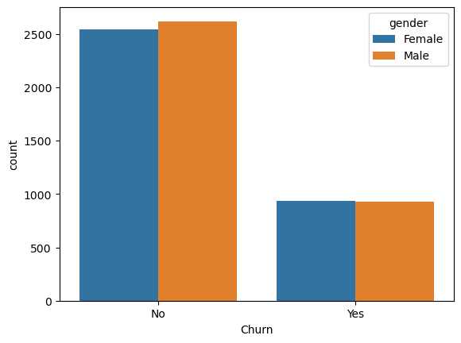
DATA VISUALISATION
INTERPRETATION
In the "No" category, there are more males than females. This indicates that among customers who didn't churn, there are more males.
In the "Yes" category, there are more females than males. This suggests that among customers who did churn, there are more females.
In summary, the bar graph represents the gender distribution of customers who either churned or did not churn

Slide 6
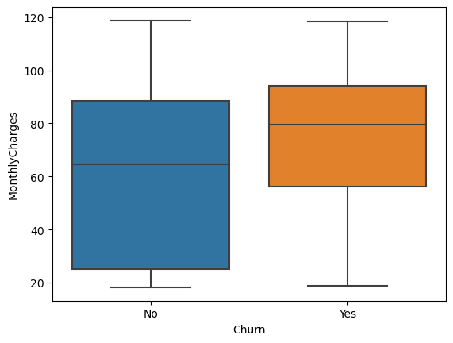
DATA VISUALISATION
INTERPRETATION
The middle line (also known as the median) of the boxplot for "no" churn is located at 65 on the Y-axis.
The middle line of the boxplot for "yes" churn is located at 80 on the Y-axis.
Comparing the two boxplots, it seems that customers who churned ("yes" churn) generally had a higher median monthly charge (80 units) compared to customers who did not churn ("no" churn, median: 65 units).
This suggests that there might be a correlation between higher monthly charges and customer churn.

Slide 7
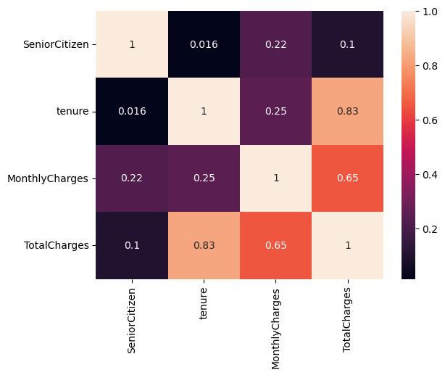
DATA VISUALISATION
A correlation coefficient of 1 indicates a perfect positive correlation, meaning that as one variable increases, the other variable also increases proportionally.
A correlation coefficient of -1 indicates a perfect negative correlation, meaning that as one variable increases, the other variable decreases proportionally.
A correlation coefficient close to 0 indicates little to no linear correlation between the variables.

Slide 8
MACHINE LEARNING MODULES
Ordinal Encoder
CODE
from sklearn.preprocessing import OrdinalEncoder
OUTPUT
oe=OrdinalEncoder()
oe.fit_transform(df[cols])
array([[0., 1., 0., ..., 1., 2., 0.], [1., 0., 0., ..., 0., 3., 0.], [1., 0., 0., ..., 1., 3., 1.], ..., [0., 1., 1., ..., 1., 2., 0.], [1., 1., 0., ..., 1., 3., 1.], [1., 0., 0., ..., 1., 0., 0.]])
The purpose of this code is to transform categorical data into numerical values, allowing machine learning algorithms to work with them effectively.
Each row of this array corresponds to a row in the original DataFrame, and each column corresponds to one of the categorical columns specified in “cols”. The numerical values in the array are the encoded representations of the categorical data.

Slide 9
DATA SPLITTING
CODE
features=df.iloc[ : , : -1]
This line extracts all the rows and all columns except the last one from the DataFrame ”df” and assigns it to the variable “features”.
CODE
target=df.iloc[ : , -1]
This line extracts all the rows and only the last column from the DataFrame ”df” and assigns it to the variable “target”.
CODE
from sklearn.model_selection import train_test_split
xtrain,xtest,ytrain,ytest=train_test_split(features,target,test_size=0.2,random_state=1)target,test_size=0.2,random_state=1)
Data has been separated into training and testing part by separating feature and target columns.

Slide 10
MACHINE LEARNING MODULES
KNEIGHBORS REGRESSOR
CODE
from sklearn.neighbors import KNeighborsRegressor
OUTPUT
mse=0.16014678792625794
neigh= KNeighborsRegressor(n_neighbors=7)
neigh.fit(xtrain,ytrain)
ypred=neigh.predict(xtest)
mse=mean_squared_error(ytest,ypred)
r2=r2_score(ytest,ypred)
print(mse,r2)
R2=0.167901174282969672
In this code an instance class is created “KNeighborsRegressor” with the parameter n_neigbors set to 7.
This means that the algorithm will consider 7 nearest neighbors when making predictions in the data point.
The “mean_squared_error” function from the sklearn.metrics module is used to calculate the MeanSquareed Error(MSE) between the actual test and the predicted values.
Finally, the calculated mse and r2 score are printed to the console.

Slide 11
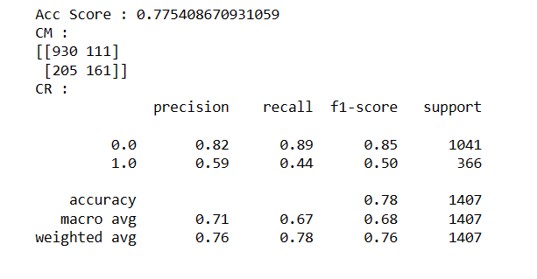
MACHINE LEARNING MODULES
KNEIGHBORS CLASSIFIER
CODE
from sklearn.neighbors import KNeighborsClassifier
OUTPUT
knn=KNeighborsClassifier(n_neighbors=7)
knn.fit(xtrain,ytrain)
ypred=knn.predict(xtest)
from sklearn.metrics import accuracy_score,confusion_matrix,classification_report
ac=accuracy_score(ytest,ypred)
cm=confusion_matrix(ytest,ypred)
cr=classification_report(ytest,ypred)
print(f"Acc Score : {ac}\nCM : \n{cm}\nCR : \n{cr}")

Slide 12
MACHINE LEARNING MODULES
LINEAR REGRESSION
CODE
OUTPUT
from sklearn.linear_model import LinearRegression
lr=LinearRegression()
lr.fit(xtrain,ytrain)
ypred=lr.predict(xtest)
lr.coef_
array([-3.73287483e-03, 5.35279873e-02, -1.10714223e-03, -1.88908494e-02, -1.49376425e-03, -1.46092502e-01, 1.52494068e-02, 5.17870307e-02, -3.73783684e-02, -2.16698234e-02, -1.67081012e-02, -4.10360000e-02, 9.92590344e-04, 5.47605977e-03, -4.66230285e-02, 4.60809990e-02, 6.02758784e-03, 6.11011988e-03, -5.64434207e-05])
In linear regression, the coefficients represent the weights assigned to each feature to calculate the predicted values.
Each coefficient value corresponds to a specific feature in the input data.
The coefficients indicate how much the predicted output changes for a one-unit change in the corresponding feature while holding other features constant.
For example, a positive coefficient suggests that an increase in the corresponding feature tends to lead to an increase in the predicted output, and a negative coefficient suggests the opposite.

Slide 13
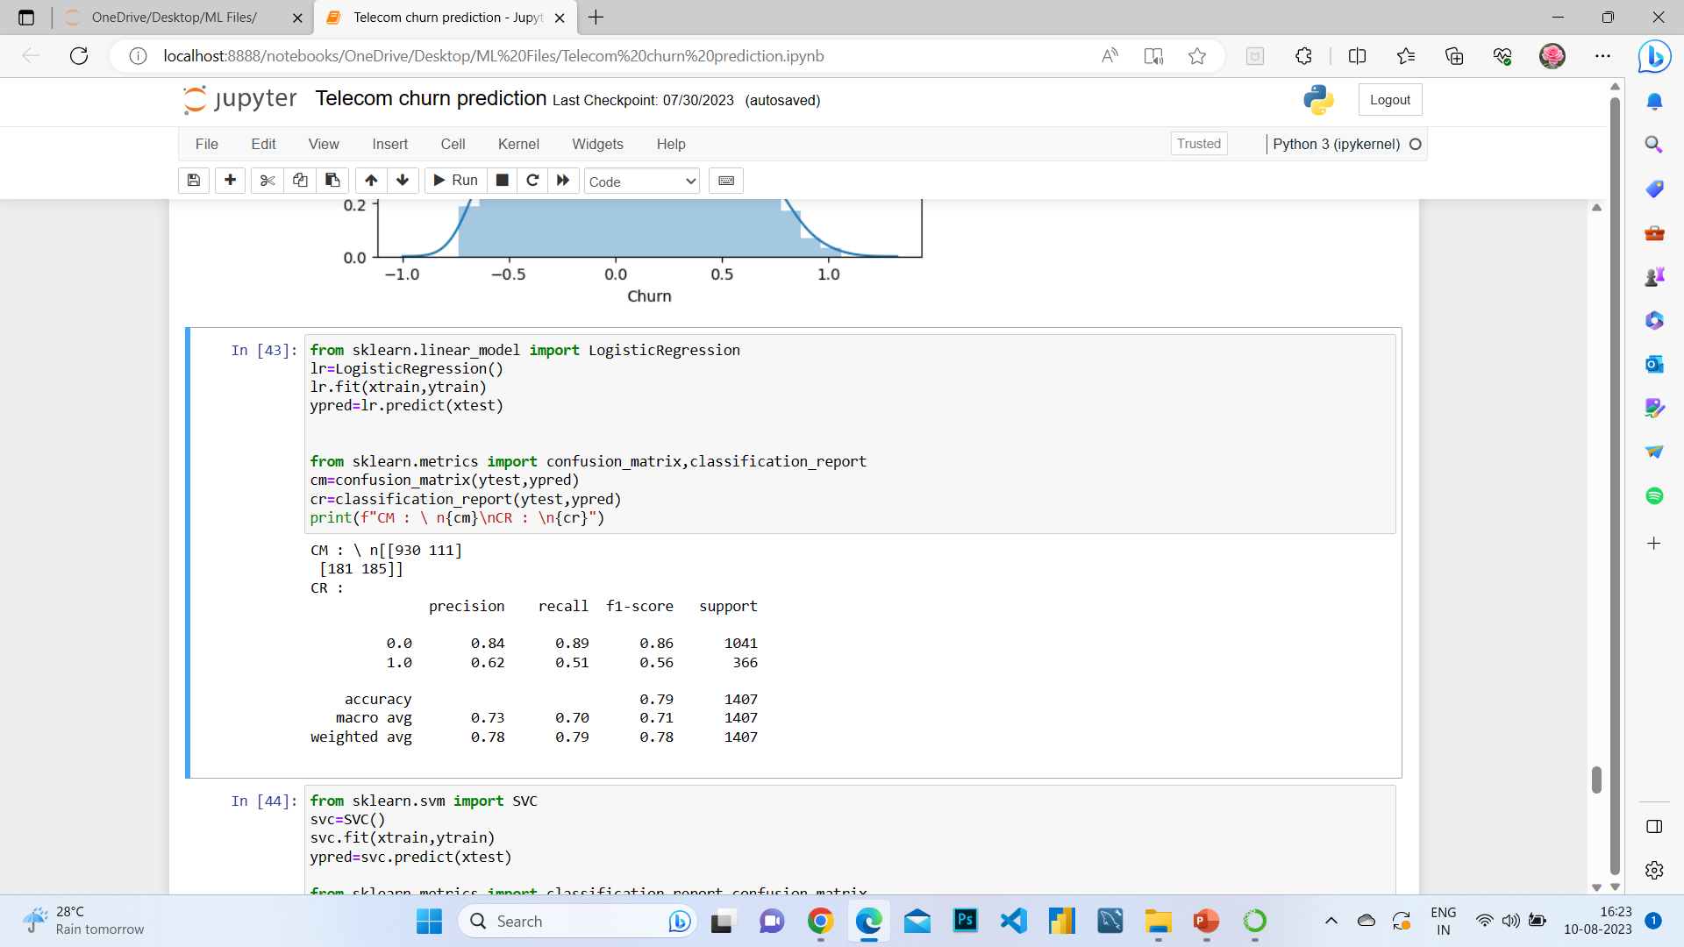
MACHINE LEARNING MODULES
LOGISTIC REGRESSION
CODE
from sklearn.linear_model import LogisticRegression
OUTPUT
lr=LogisticRegression()
lr.fit(xtrain,ytrain)
ypred=lr.predict(xtest)
from sklearn.metrics import confusion_matrix,classification_report
cm=confusion_matrix(ytest,ypred)
cr=classification_report(ytest,ypred)
print(f"CM : \ n{cm}\nCR : \n{cr}")

Slide 14
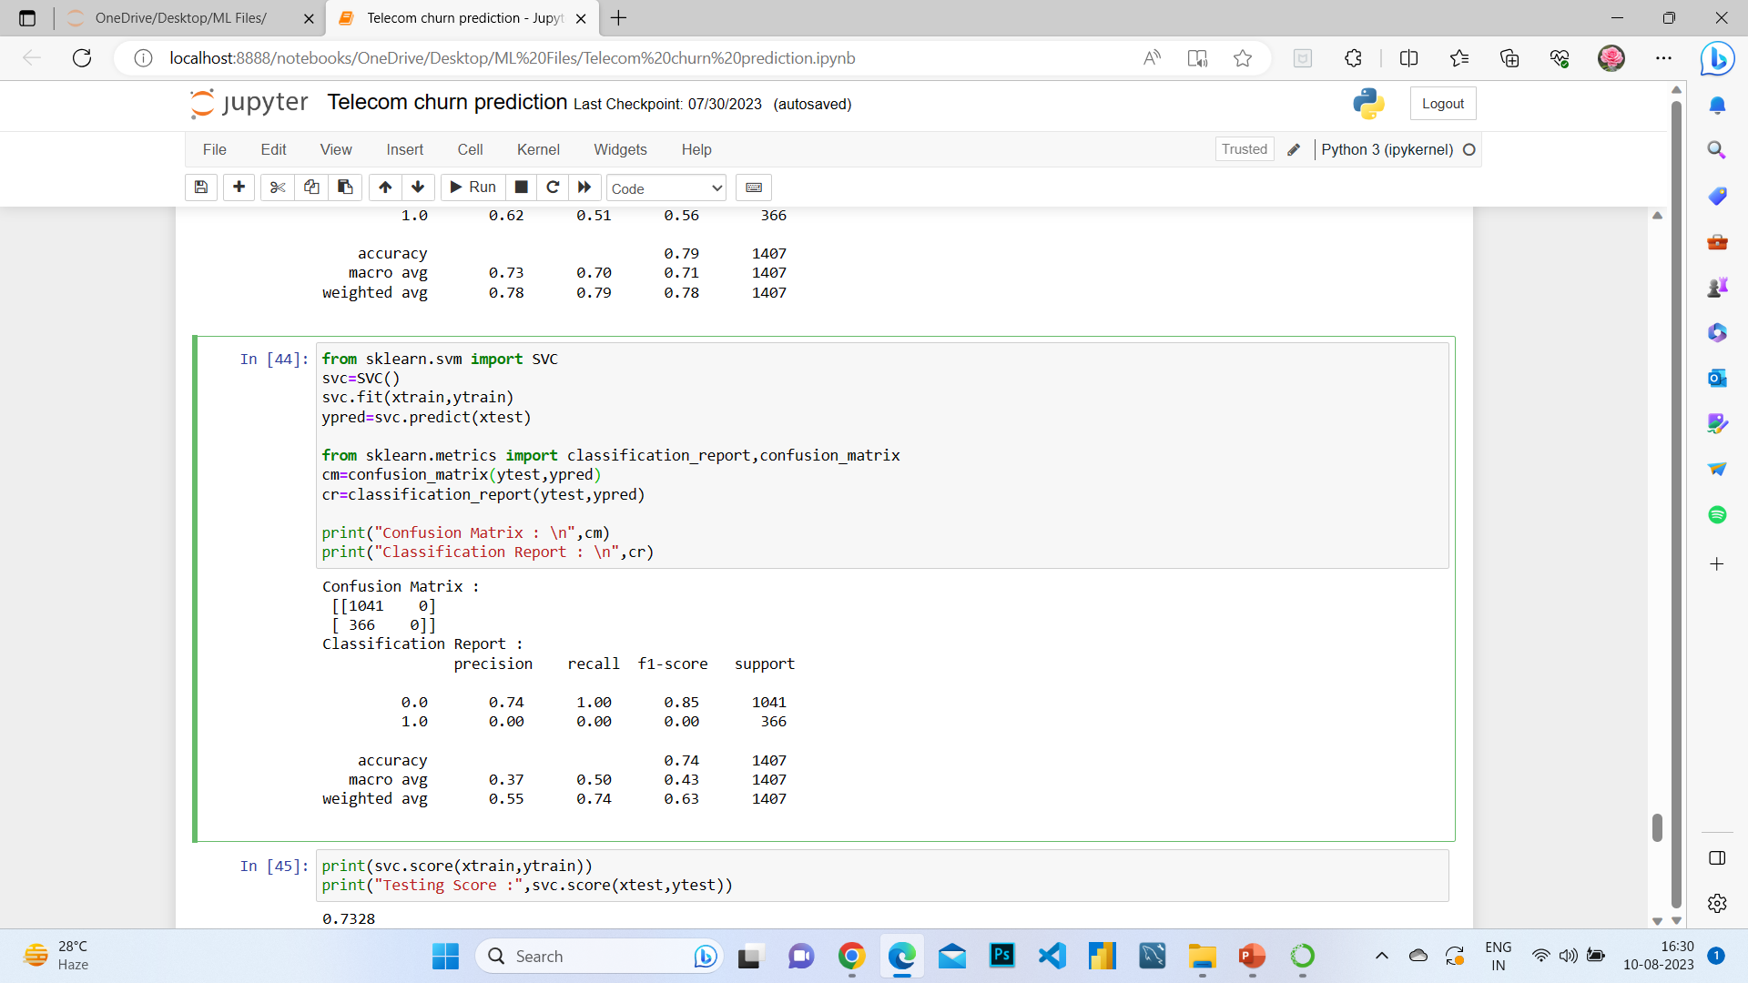
MACHINE LEARNING MODULES
SUPPORT VECTOR MACHINE
CODE
from sklearn.svm import SVC
OUTPUT
svc=SVC()
svc.fit(xtrain,ytrain)
ypred=svc.predict(xtest)
from sklearn.metrics import classification_report,confusion_matrix
cm=confusion_matrix(ytest,ypred)
cr=classification_report(ytest,ypred)
print("Confusion Matrix : \n",cm)
print("Classification Report : \n",cr)

Slide 15
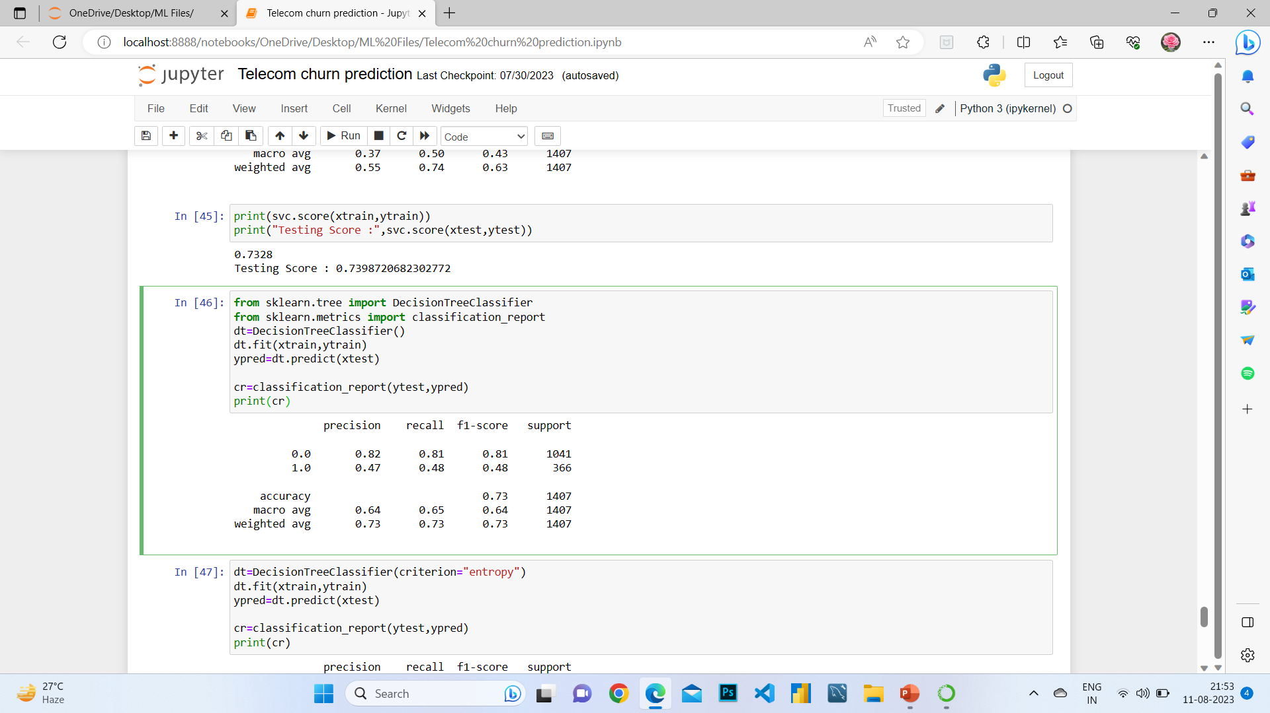
MACHINE LEARNING MODULES
DECISION TREE CLASSIFIER
CODE
from sklearn.tree import DecisionTreeClassifier
OUTPUT
from sklearn.metrics import classification_report
dt=DecisionTreeClassifier()
dt.fit(xtrain,ytrain)
ypred=dt.predict(xtest)
cr=classification_report(ytest,ypred)
print(cr)

Slide 16
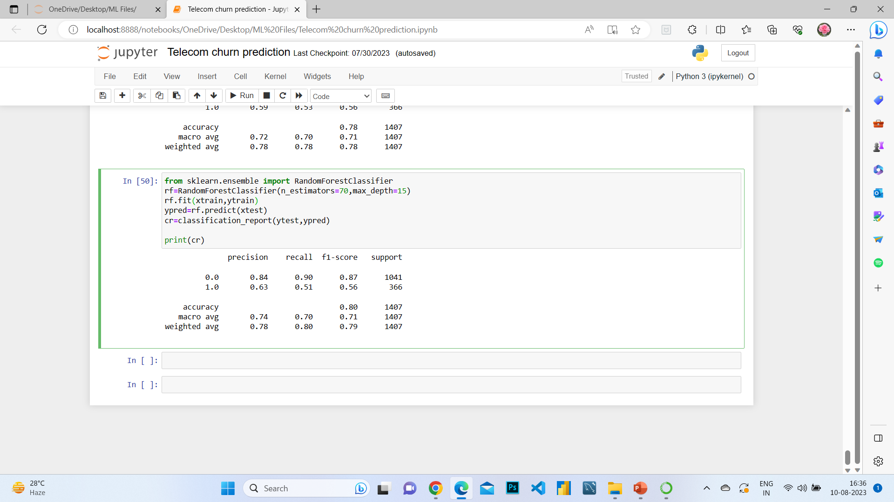
MACHINE LEARNING MODULES
RANDOM FOREST CLASSIFIER
CODE
from sklearn.ensemble import RandomForestClassifier
OUTPUT
rf=RandomForestClassifier(n_estimators=70,max_depth=15)
rf.fit(xtrain,ytrain)
ypred=rf.predict(xtest)
cr=classification_report(ytest,ypred)
print(cr)

Slide 17

THANK YOU

